Slide 1
Measures of Variability
R. Garner, DePaul University

Slide 2
Review of “Describing the Distribution of a Variable”
This PowerPoint repeats material in the “Describing the Distribution of a Variable” PowerPoint and adds a few questions

Slide 3
Measures of variability
These are summary ways of describing how variable, dispersed, or spread a distribution is. Is the distribution tightly clustered or “congregated” around its mean, or is it spread out?
For a time sequence of observations, we can ask if the values are volatile—variable over time, now up and now down. For example, do prices of stocks or soap fluctuate a lot?

Slide 4
The range
One measure of variability for numerical variables is the range, found by subtracting the smallest value (minimum) in the distribution from the largest value (maximum).
This summary measure can be useful, but it does not tell us very much about how close the observations are to the mean. For example, all but two of them could be very close to the mean, but the maximum and minimum far away.

Slide 5
Standard deviation and variance
For numerical data, the most commonly used measures of variability are the standard deviation and the variance.
Look carefully at the next slide, with the formula for the population and sample standard deviation.

Slide 6
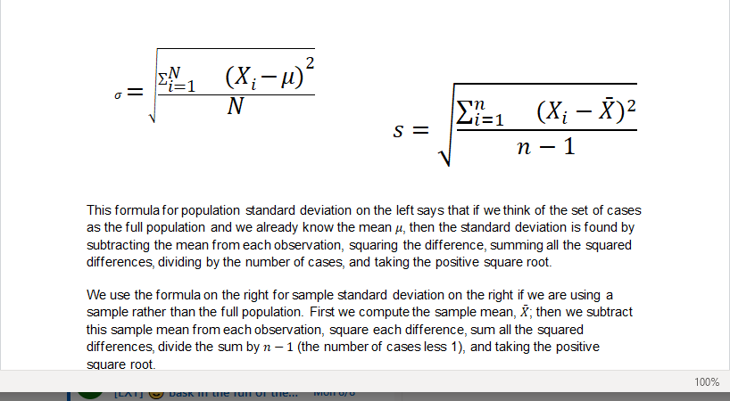
Formula for the standard deviation

Slide 7
Standard deviation (continued)
The formulas for the standard deviation for a sample (s) and for a population (σ, called sigma—lower case!) are basically the same.
We subtract the mean from each observation, square the difference, add up the squares, and divide the sum of squares by the number of cases. If we are looking at sample data, we divide by (n -1).
Then we take the positive square root.

Slide 8
The variance
The variance is the number we got in the calculation of the standard deviation BEFORE we took the positive square root.
It is the mean of the sum of the squared deviations from the mean.

Slide 9
ALERT
Memorizing the formula for the standard deviation (and variance) is HIGHLY RECOMMENDED!

Slide 10
Index of diversity for categorical variables
An index of diversity can be calculated for categorical data, for a variable that measures diversity.
For example, how gender diverse is this graduating class of Air Force pilots?
How ethnically (or racially) diverse is this police department?
The index includes the number of categories and the evenness of distribution in the categories.

Slide 11
Algorithm for index of diversity (see the text for the formula)
Find the proportion of cases in each category of the variable (fraction or decimal fraction).
Square each proportion. This will give you one square for each category.
Add all the squares, one for each category (sum of squares).
Subtract the sum of the squared proportions from 1.

Slide 12
Warm-up Question: the count, the peasants, the shoes, and the mean
Remember the count, the countess, the overseer, the peasants, the shoes, and the Mean Commissar from the PowerPoint about Measures of Central Tendency?
Before the Mean Commissar redistributes the shoes, what is the standard deviation of the shoe distribution? (Count had 50 pairs, Countess had 50 pairs, Overseer had 3 pairs, and the 100 peasants had 0 pairs.)
And what is the standard deviation after all the shoes are redistributed so that each person has one pair?

Slide 13
Class exercise
This exercise works best in a class with about 15-30 people. You can enter the numbers everyone provides in a computer (or calculator with the mean and SD or in an online SD calculator).
Find a numerical variable with which everyone is comfortable (not everyone is comfortable with height, weight, GPA, etc.!) and collect the data (for example, on scraps of paper).
Find the mean, variance, and SD for this variable.

